Slide 1
Team Trivia Night
Grab a drink while we wait for everyone to join...

Slide 2
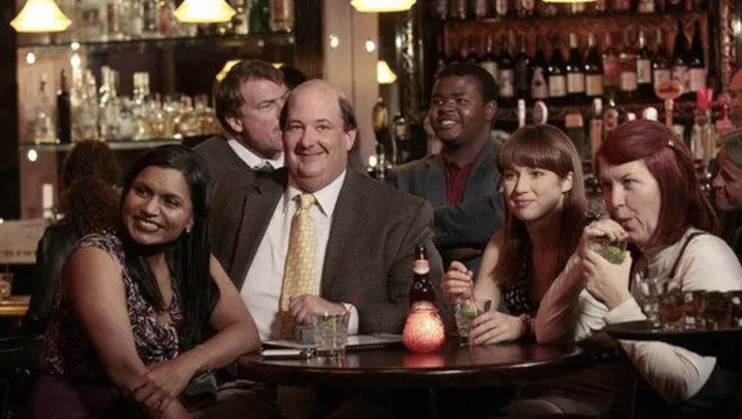

Slide 3
Getting started
I will randomly break you up into teams and assign a team leader
Communicating as a team
For The Adventurous: Team leaders, spin up a new High Five, and send the link to your team so you can discuss your answers in secret.
For the Less Adventurous: If you hate High Five with the fire of a thousand suns, you can create a private DM to discuss answers.
For the Overachievers: Do both!

Slide 4
The rules
No using Google, spouses or children to get the answer
Only one answer per team
You’ll have 30 seconds to discuss and send your answer along with your team name in a DM to Emily
Teams that accidentally broadcast answers to the Zoom meeting will be deducted 5 points, so...

Slide 6
The winning team gets….

Slide 7
Bragging rights and the honor of choosing the next game.

Slide 8
Round 1

Slide 9
What are London police officers traditionally known as?
Question 1

Slide 10
What did the crocodile swallow in Peter Pan?
Question 2

Slide 11
Which German city is famous for the perfume it produces?
Question 3

Slide 12
What is the sixth planet from the sun?
Question 4

Slide 13
How many valves does a trumpet have?
Question 5

Slide 14
What “King” of golf lent his name to a mixture of iced tea and lemonade?
Question 6

Slide 15
What two sisters faced each other in the finals of the French Open, Wimbledon, and US Open in 2002?
Question 7

Slide 16
A poke bowl is a diced raw fish dish that originated in which U.S. state?
Question 8

Slide 17
Whose dress was dried like jerky for the Rock & Roll Hall of Fame?
Question 9

Slide 18
Which video game studio created the popular online game Fortnite?
Question 10

Slide 19
Round 2

Slide 20
How many dots are there on two dice?
Question 1

Slide 21
When did the First World War start?
Question 2

Slide 22
What horoscope sign is a crab?
Question 3

Slide 23
Which actress has won the most Oscars?
Bonus Point: How many has she won?
Question 4

Slide 24
Which continent contains the world's largest desert?
Question 5

Slide 25
A word that is spelled the same forward and backward is called what?
Question 6

Slide 26
Who became both a vice president and president of the United States without ever being elected to either office?
Question 7

Slide 27
When referring to cables used to transmit audio/video, what does HDMI stand for?
Question 8

Slide 28
What is the only mammal born with horns?
Question 9

Slide 29
The expression “oy vey” comes from what language?
Question 10

Slide 30
Round 3

Slide 31
Who discovered penicillin?
Question 1

Slide 32
What does the Roman numeral C represent?
Question 2

Slide 33
What is the only mammal that can’t jump?
Question 3

Slide 34
What company is the world's biggest distributor of toys?
Question 4

Slide 35
How many times was the Men's Tennis Singles at Wimbledon won by Bjorn Borg?
Question 5

Slide 36
What gives red blood cells their color?
Question 6

Slide 37
When referring to an establishment that sells alcoholic drinks, what is the word “pub” short for?
Question 7

Slide 38
Who was the first female Prime Minister of a European country?
Question 8

Slide 39
Who is the only basketball player to score 100 points in a single NBA game?
Question 9

Slide 40
What happened to British street artist Banksy’s “Girl with Balloon” when it sold for $1.4 million at auction?
Question 10

Slide 41
Final Question

Slide 42
Put the following events in chronological order:
The euro is introduced as legal currency on the world market
Ghostbusters hits theaters
The end of the Cold War
The launch of the Hubble Space Telescope
Bill Clinton elected president

Slide 43
And the winning team is…

Slide 44
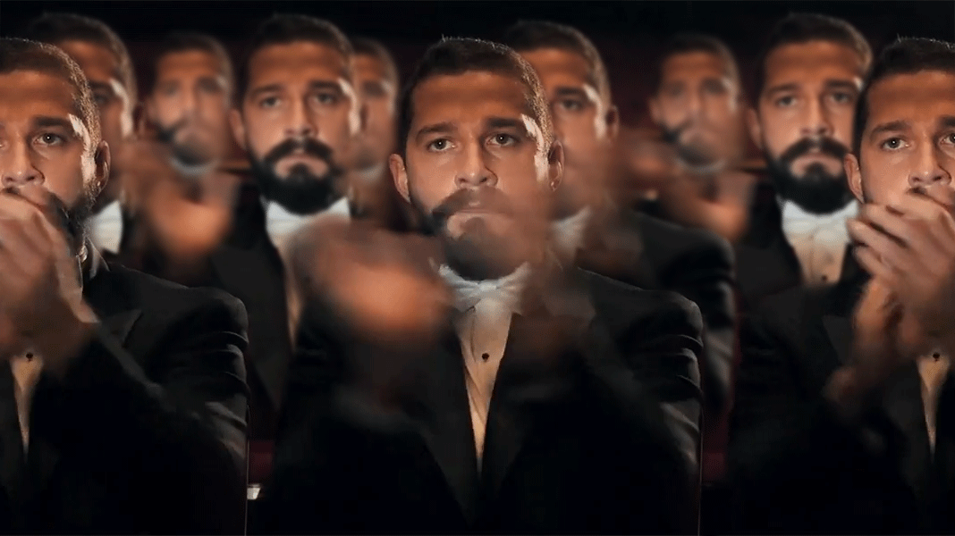

Slide 45
Thanks for coming!

